Slide 1
MENTAL HEALTH DETECTION USING DEEP NEURAL NETWORK AND ENSEMBLE MACHINE LEARNING TECHNIQUES
GADHA S PANICKER: 05
M.SC COMPUTER SCIENCE(DATA ANALYTICS)

Slide 2
INTRODUCTION
Mental health is a crucial aspect of overall well-being, especially in today's fast-paced and high-pressure environments.
The goal is to predict an individual’s mental health condition based on survey responses and behavioral indicators such as gender, occupation, family history, treatment etc.
By doing so, we aim to build predictive models that can help in early detection and provide insights that support mental wellness in both personal and professional spaces.
The dataset is downloaded from the Kaggle, and then applied deep learning and ensemble machine learning algorithms.
The target variable is “treatment”. Algorithms used are Random Forest Classifier, XG Boost, AdaBoost, K-Nearest Neighbors, and Artificial Neural Network (ANN).
By using the above models, the best fit model is ANN with 0.8031 as the accuracy.

Slide 3
DATASET DESCRIPTION
This dataset has been taken from kaggle.
The dataset comprised of individual responses regarding mental health, including demographic details, workplace environment, stress levels, and treatment history.
The dataset contains 2,92,364 rows and 17 columns.

Slide 4
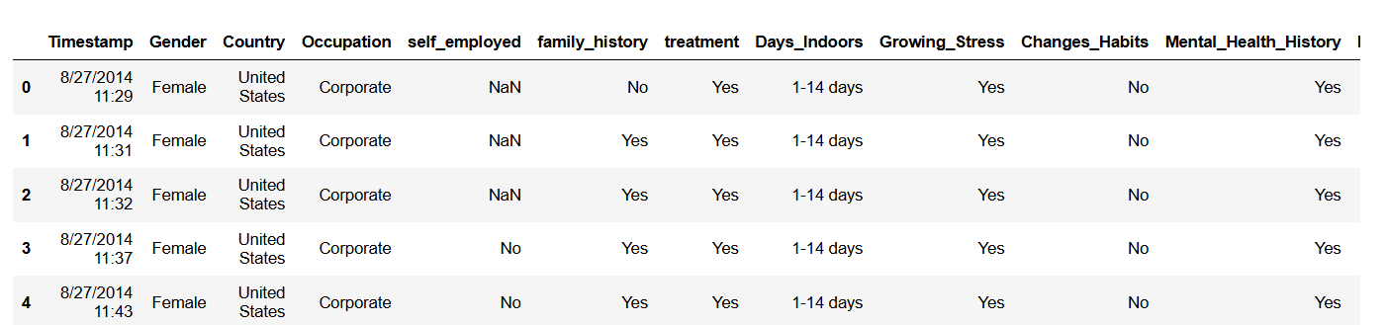
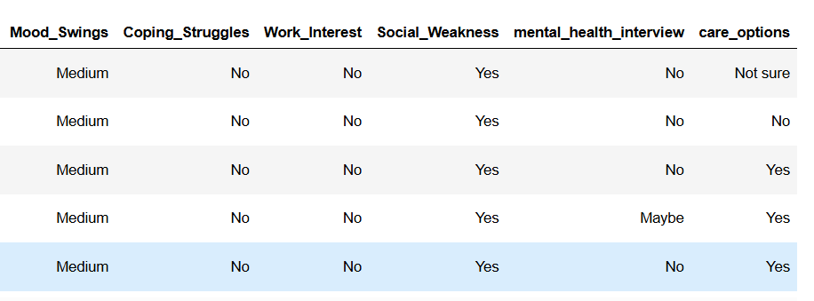

Slide 5
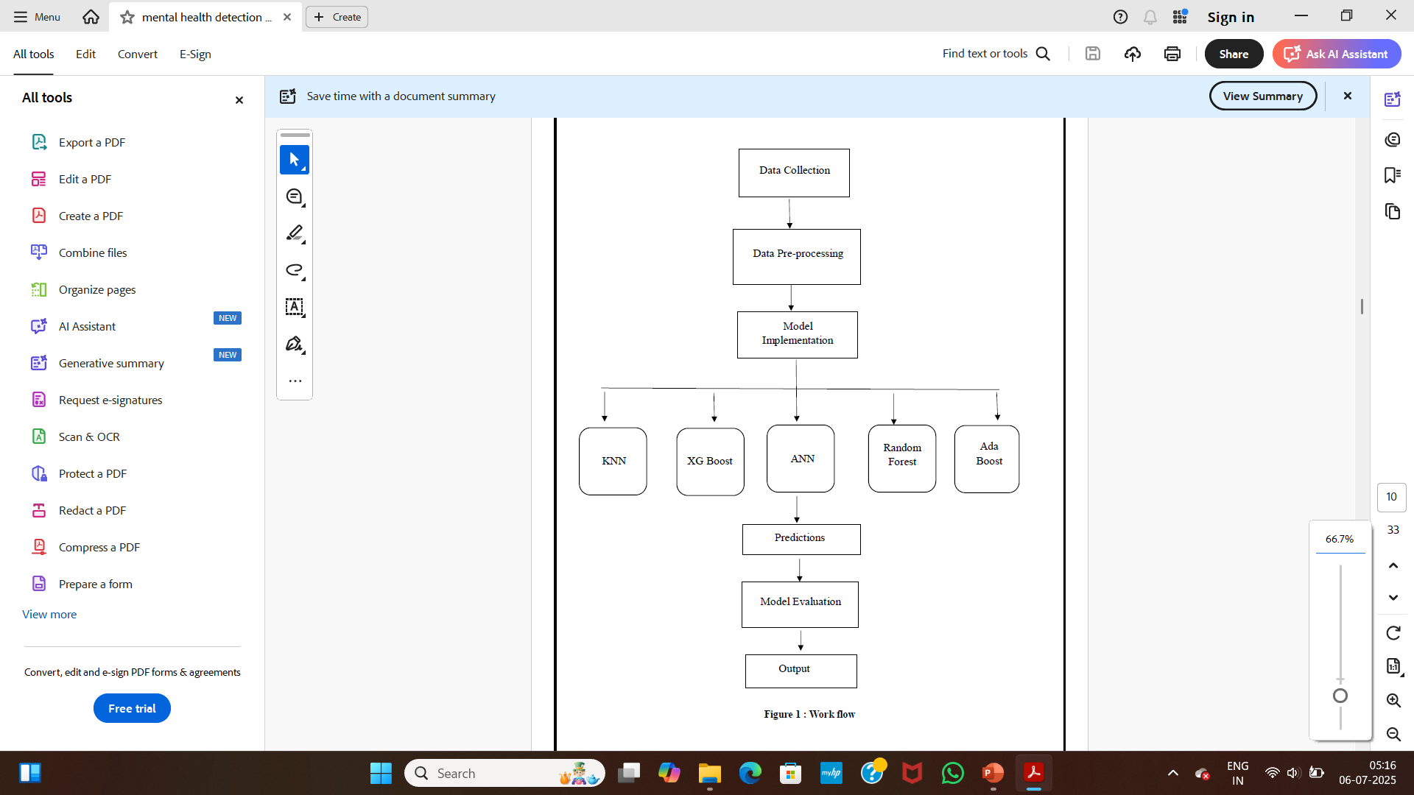
METHODOLOGY
Data pre-processing
Data visualization
Data split
Model building
Evaluation of models

Slide 6
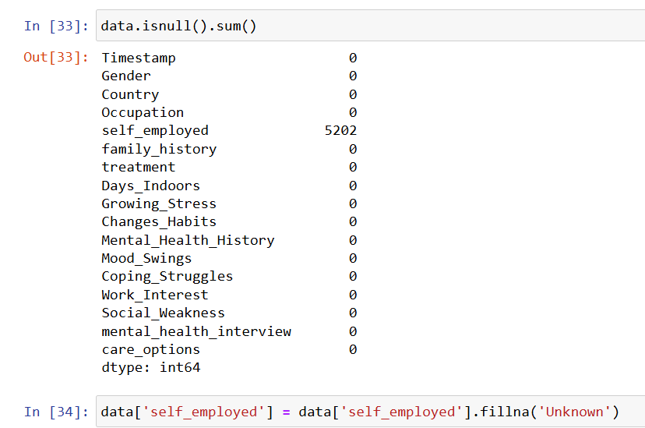
Data pre-processing
Data set handled by data handling methods.
The dataset checked for null values.
The dataset checked duplicate values.
Irrelevant column such as Timestamp were dropped as they do not contribute to the analysis.
Applied Label Encoding to convert categorical text data into numerical form for machine learning.
Replaced null values in self_employed with “unknown”

Slide 7
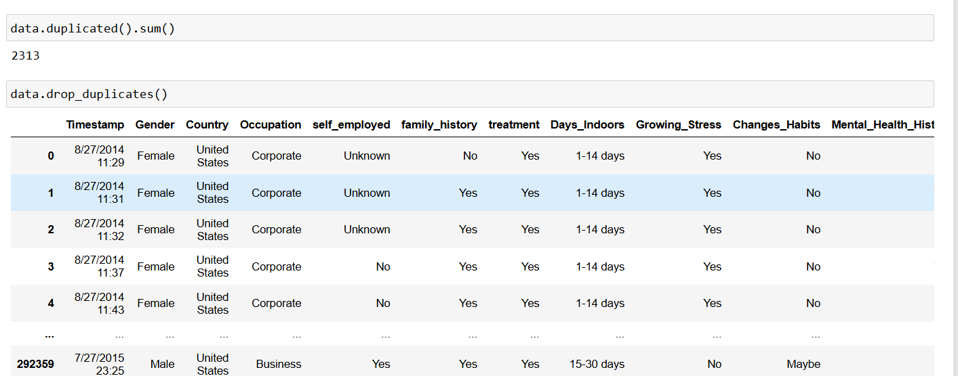
Identified and removed duplicate entries to ensure data quality and avoid bias in analysis.

Slide 8
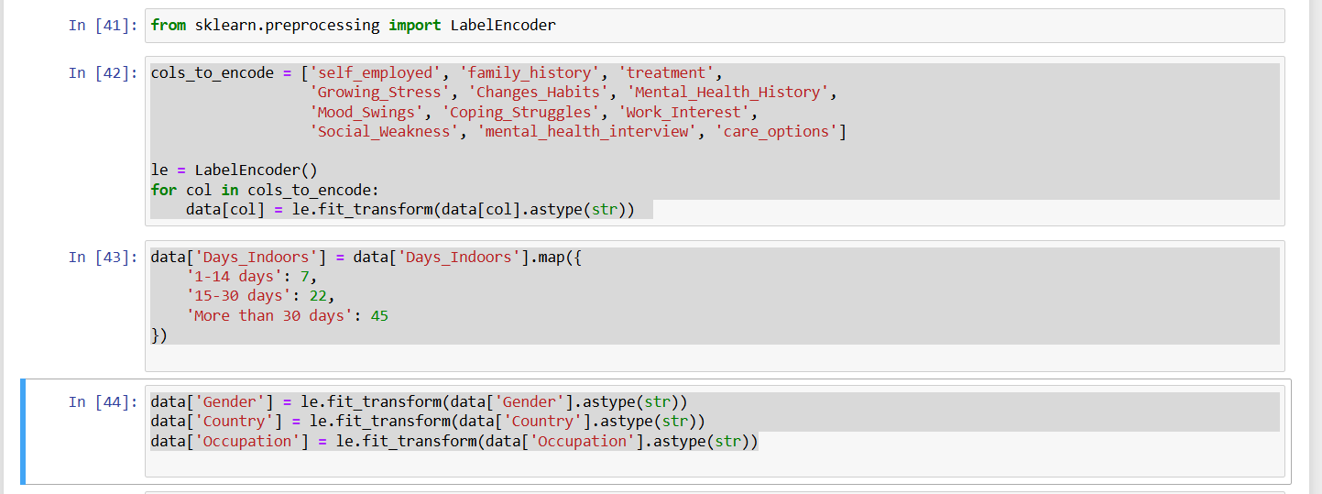
Encoding Categorical Variables
Applied Label Encoding to all categorical columns to convert text categories into numbers.
Helps models understand and use categorical data for training and prediction.

Slide 9
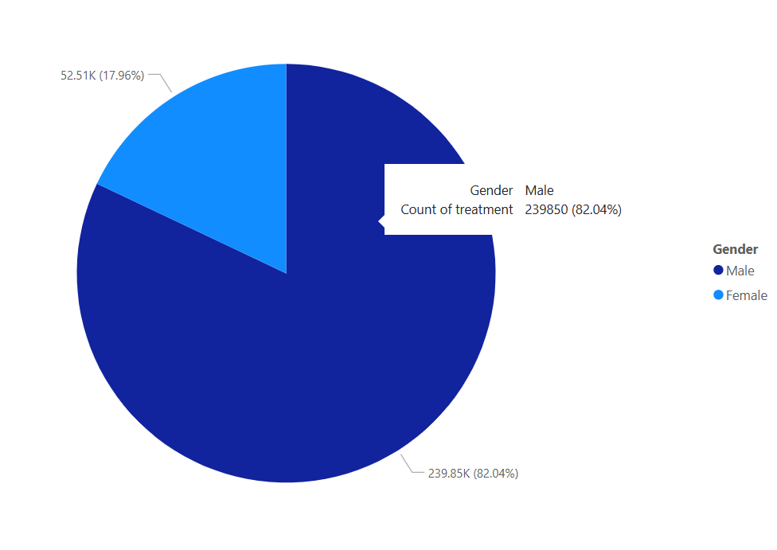
Data Visualization
1. Pie Chart
Most treatments were given to male patients – 82.04% (about 239,850).
Only 17.96% of treatments were for female patients (about 52,510).

Slide 10
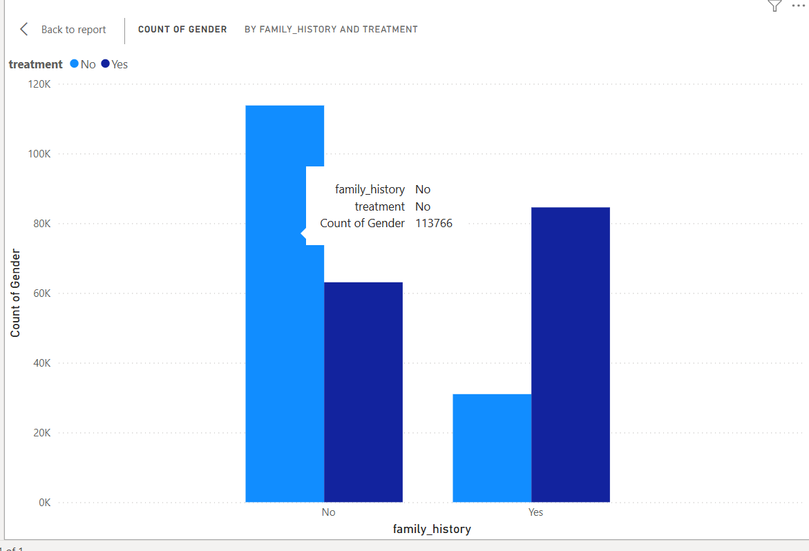
2. Clustered column chart
People with a family history are more likely to take treatment.
People without a family history are less likely to take treatment.

Slide 11
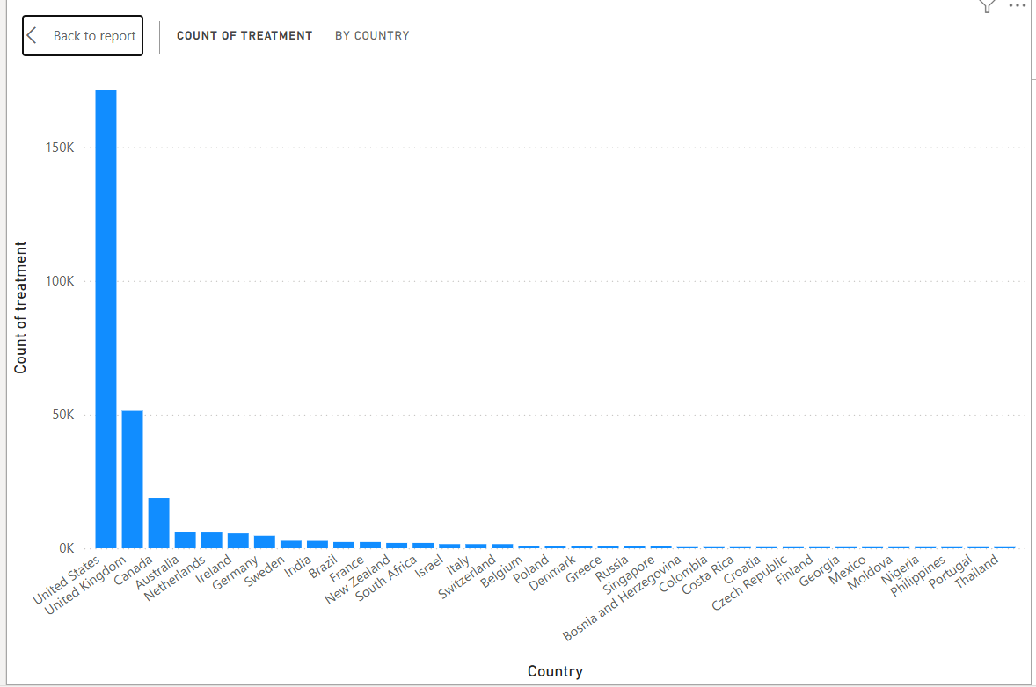
3. Stacked column chart

Slide 12
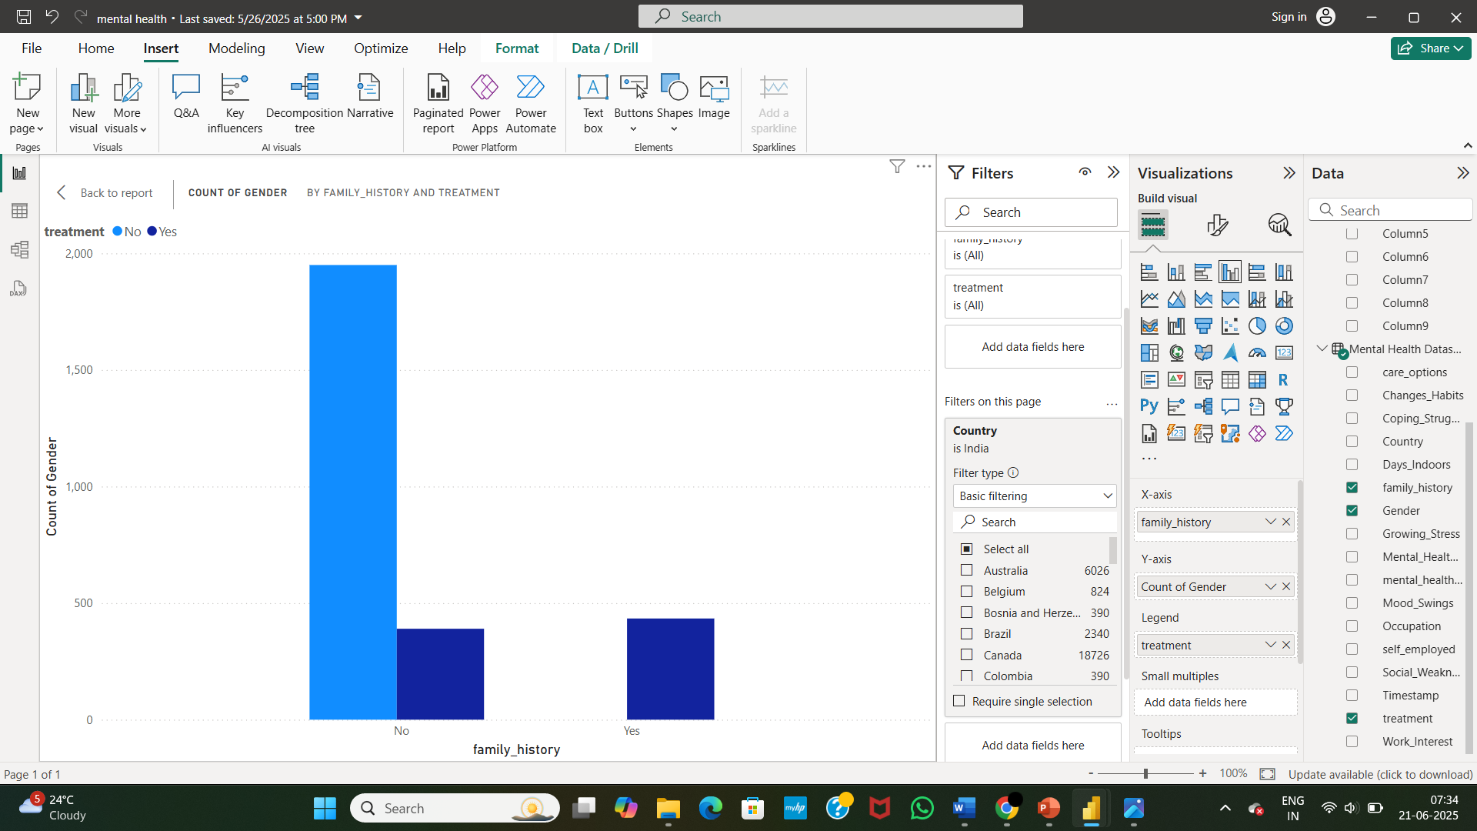
4. Mental Health Treatment Distribution in India Based on Family History and Gender
People with a family history of mental illness are more likely to seek treatment.
People without a family history are less likely to seek treatment and mostly do not take treatment.

Slide 13
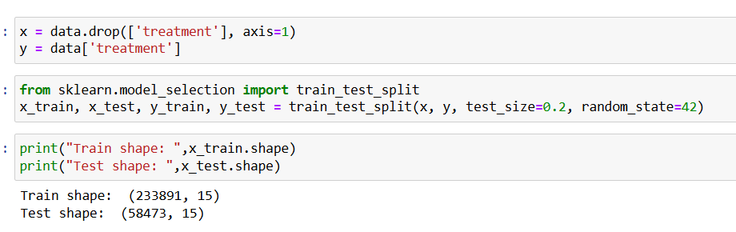
Data Split
Here we split the dataset into train and test.

Slide 14
Model Building
Algorithms used for model building are:
ANN
Random Forest Classifier
XG Boost
Ada Boost
KNN

Slide 15
RESULTS
1. Classification Report
Classifiers | Precision | Recall | F1-score
K-Nearest Nighbors | 0.72 | 0.72 | 0.72
Random Forest Classifier | 0.78 | 0.71 | 0.75
XG Boost | 0.82 | 0.72 | 0.77
Ada Boost | 0.72 | 0.72 | 0.72
Artificial neural network | 0.80 | 0.84 | 0.82
Among all classifiers, the Artificial Neural Network (ANN) performed best with the highest F1-score of 0.82 and recall of 0.84, making it the most effective model for detecting mental health issues in this dataset

Slide 16
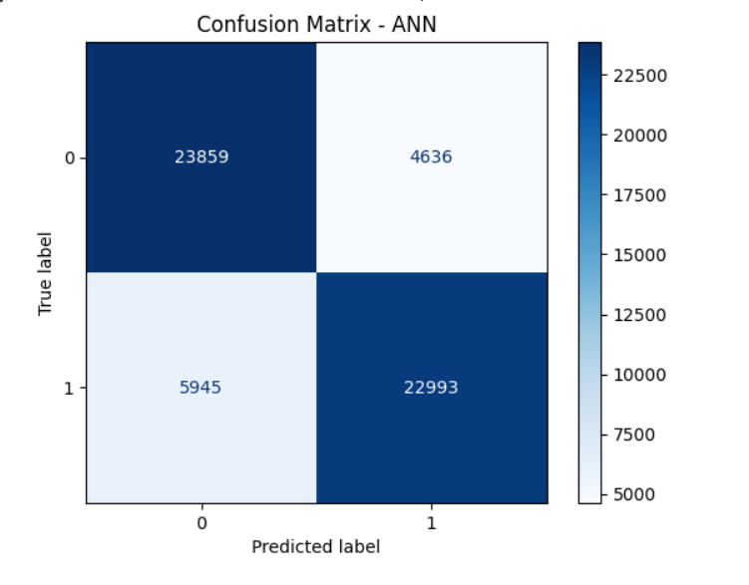
2. Confusion Matrix
Confusion Matrix for ANN

Slide 17
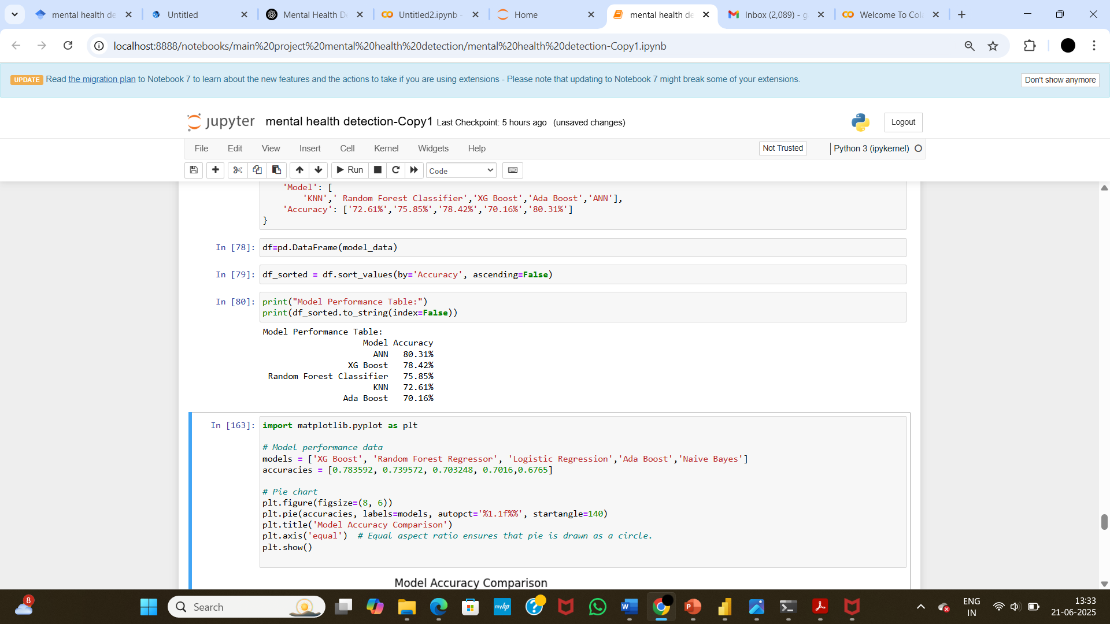
3. Accuracy
From the results, it is evident that the deep learning model (ANN) achieved the highest accuracy at 80.31%, showing its capability to capture complex patterns in the data. Among the traditional machine learning models, XG Boost outperformed the others, achieving 78.42%, which highlights the strength of gradient boosting in handling structured data.

Slide 18
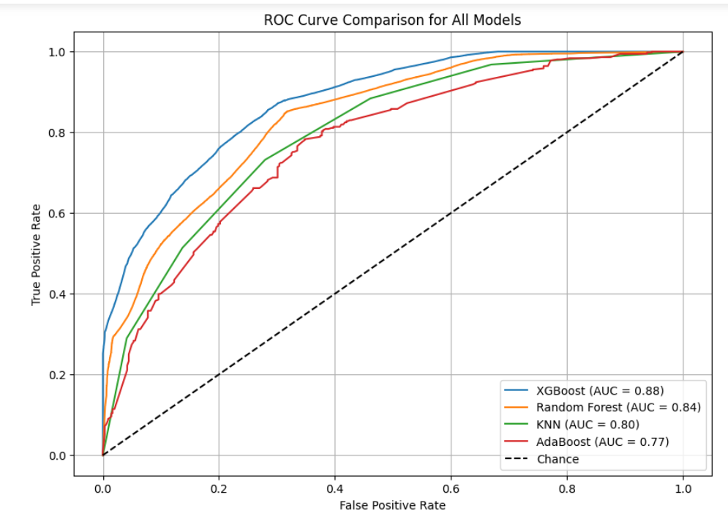
4. Model Evaluation Using ROC-AUC Scores
ROC Curve Comparison for all models

Slide 19
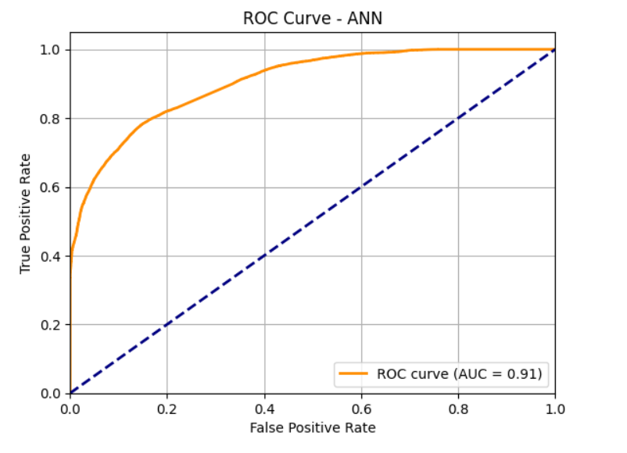
ROC curve for ANN

Slide 20
CONCLUSION & FUTURE SCOPE
Conclusion
Survey data analyzed using ML & DL models: KNN, RF, AdaBoost, XG Boost, ANN.
ANN performed best with 80.31% accuracy and AUC: 0.91, showing strong pattern recognition.
XG Boost also showed solid performance (78.42% accuracy).
Models evaluated using Precision, Recall, F1-Score, Confusion Matrix, ROC-AUC.
Future Scope
Real-time data integration from apps, wearables, or social media for early detection.
Customization for India: regional languages, cultural context, and local insights.
Web/mobile app deployment to support self-assessment in rural/underserved areas.

Slide 21
BIBLIOGRAPHY
Sharma, S.K., Alutaibi, A.I., Khan, A.R. et al. Early detection of mental health disorders using machine learning models using behavioral and voice data analysis. Sci Rep 15, 16518 (2025). https://doi.org/10.1038/s41598-025-00386-8
Abd Rahman, Rohizah, et al. "Application of machine learning methods in mental health detection: a systematic review." Ieee Access 8 (2020): 183952-183964.
Khoo, Lin Sze, et al. "Machine learning for multimodal mental health detection: a systematic review of passive sensing approaches." Sensors 24.2 (2024): 348.
Costello, E. J. (2016). Early Detection and Prevention of Mental Health Problems: Developmental Epidemiology and Systems of Support. Journal of Clinical Child & Adolescent Psychology, 45(6), 710–717. https://doi.org/10.1080/15374416.2016.1236728
Abd Rahman, Rohizah, et al. "A survey on mental health detection in online social network." International Journal on Advanced Science, Engineering and Information Technology 8.4-2 (2018): 1431-1435.
Hassantabar, Shayan, et al. "Mhdeep: Mental health disorder detection system based on wearable sensors and artificial neural networks." ACM Transactions on Embedded Computing Systems 21.6 (2022): 1-22.
Tiwari, Amit Kumar, Shivani Pandey, and Raghvendra Kumar Pandey. "Mental health detection using machine learning." Artificial Intelligence and Information Technologies (2024): 315-320.
Kim, Jina, Daeun Lee, and Eunil Park. "Machine learning for mental health in social media: bibliometric study." Journal of Medical Internet Research 23.3 (2021): e24870.
Liu, Danxia, et al. "Detecting and measuring depression on social media using a machine learning approach: systematic review." JMIR Mental Health 9.3 (2022): e27244.
Garg, Muskan. "Mental health analysis in social media posts: a survey." Archives of Computational Methods in Engineering 30.3 (2023): 1819-1842.

Slide 22
THANK YOU

